Slide 1
Dwellings prices in the DC metropolitan area
By Christopher Montgomery , Abhishek Nimmakayala , Swetha Kalla , Mojahid Osman

Slide 2
Are dwellings in the DC metropolitan area priced significantly differently from one another based on quadrant?
SMART Question

Slide 3
Secondary Smart Questions:
Do dwellings in different DC quadrant share similar characteristics?
(Chi-Square tests for categorical variables and ANOVA for continuous)
Average Dwelling Age
Date of last refurbishment (Year, treated as continuous)
Number of Bedrooms
Type of Dwelling
Number of Baths
Square footage
Air Conditioning (categorical)
Stories
Kitchens
Fireplaces
Condition (categorical)
Land Area of Property
Dwelling Type (cateogorical)

Slide 4
Source Data
The source data housing dataset created by DC.gov (obtained on Kaggle), containing dwelling characteristics for all homes in DC.

Slide 5
Data Glossary
Variable | Description
BATHRM | Number of Full Bathrooms
HF_BATHRM | Number of Half Bathrooms (no bathtub or shower)
HEAT | Heating
AC | Cooling
NUM_UNITS | Number of Units
ROOMS | Number of Rooms
BEDRM | Number of Bedrooms
AYB | The earliest time the main portion of the building was built
YR_RMDL | Year structure was remodeled
EYB | The year an improvement was built more recent than actual year built
STORIES | Number of stories in primary dwelling
SALEDATE | Date of most recent sale
PRICE | Price of most recent sale
QUALIFIED | Qualified
STYLE | Style
STRUCT | Structure
GRADE | Grade
Data Glossary (Continued)

Slide 6
Data Glossary (Continued)
Variable | Description
CNDTN | Condition
EXTWALL | Extrerior wall
ROOF | Roof type
INTWALL | Interior wall
KITCHENS | Number of kitchens
FIREPLACES | Number of fireplaces
LANDAREA
SOURCE | Raw Data Source
LIVING_GBA | Gross building area in square feet
FULLADDRESS | Full Street Address
ZIPCODE | Zip Code
LATITUDE | Latitude
LONGITUDE | Longitude
ASSESSMENT_NBHD | Neighborhood ID
WARD | Ward (District is divided into eight wards, each with approximately 75,000 residents)
SQUARE | Square (from SSL)
QUADRANT | City quadrant (NE,SE,SW,NW)

Slide 7
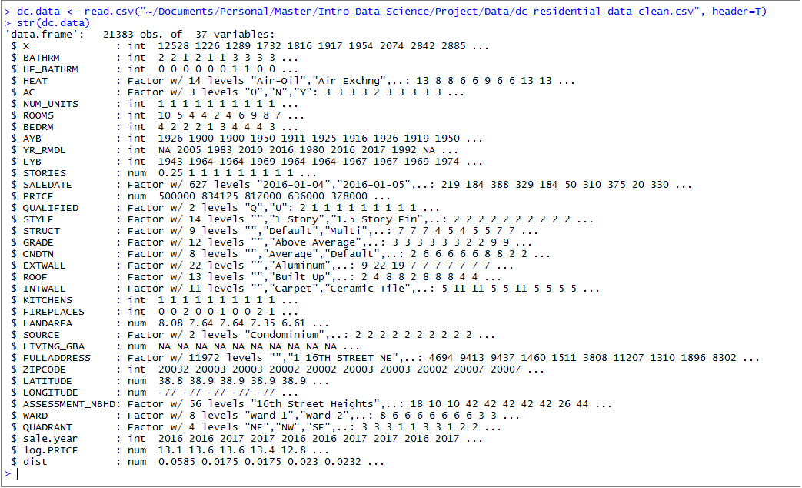
Data Glossary (Continued)

Slide 8
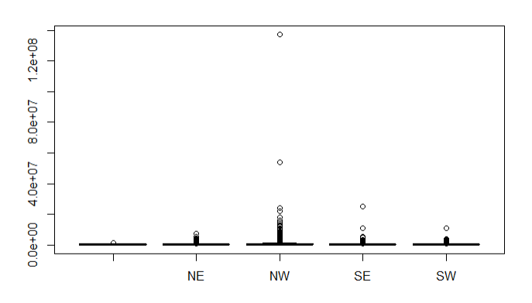
Data Prep Raw Data – Outlier

Slide 9
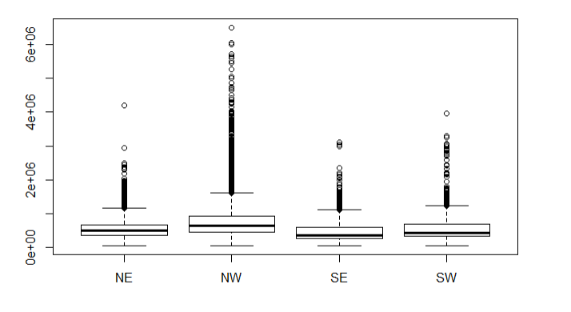
Data Prep Clean Data

Slide 10
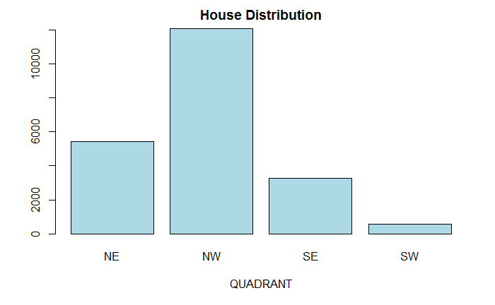

Analysis #Count of houses by Quadrant.

Slide 11

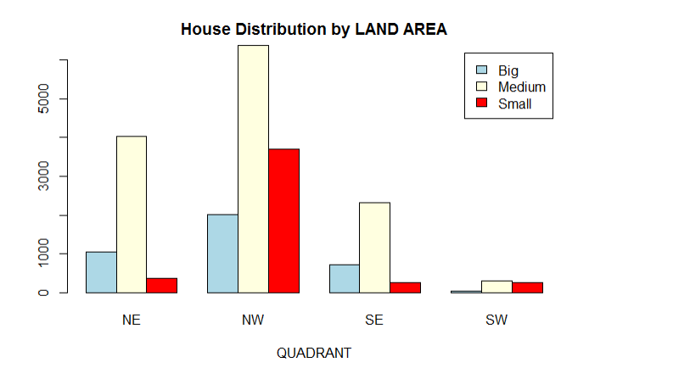
#Some analysis based on landarea #Create new variables for area category (Small, Medium , Big)

Slide 12
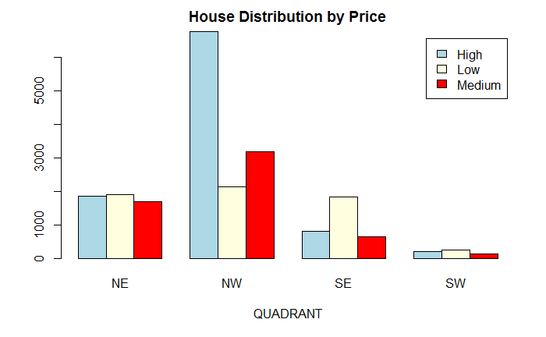

#Some analysis based on Price #Create new variables for Price Group (Low, Medium , High)

